Slide 1
Grapevine AMBUCS
Inspiring Mobility and Independence

Slide 2
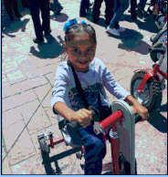
What Is Grapevine AMBUCS?
AMBUCS is
An old acronym for American Business Clubs, Grapevine chapter was founded in 1980.
A 501 C (3) charitable service organization, focused primarily in Grapevine, TX and Northeast Tarrant County.
Part of a national organization of approximately 6,000 members in 150 chapters in 30 states, founded in 1922.
Our mission? Inspiring mobility and independence!

Slide 3
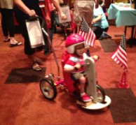
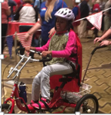
How Do We Fulfill Our Mission?
We raise funds to purchase, assemble and donate therapeutic AmTrykes for people with disabilities to improve mobility, health, and develop independence.
We fund scholarships for physical therapy (and related fields of studies) students.
Upon request, we build ADA compliant access ramps.

Slide 4
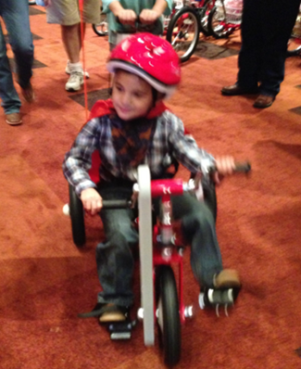
How Do We Fulfill Our Mission?
AMBUCS’ network of Physical Therapists - spread throughout DFW - determine the need and size of the AmTryke.
Once we get an application, it takes 90 to 120 days to get an AmTryke ordered, assembled and delivered.
AmTrykes are found in schools, hospitals, therapy centers and lots of private homes.
We have never turned an applicant down.

Slide 5
Our Success?
Since 1980, we’ve donated over 2,600 therapeutic AmTrykes.
Since 2002, we have provided over $200,000 in scholarships to 160 recipients!
In our fiscal year that ended on May 31, 2020 we provided 160 AmTrykes!
We have over 60 members
We are a non-profit participant in Grapevine’s Main Street Fest, GrapeFest, Grapevine’s Veterans Day Parade and other community functions.
We are funded by outright donations, funds raised from festival participation, city sponsored events and charitable golf tournaments. Our newest supporter? Five Star Subaru of Grapevine!

Slide 6
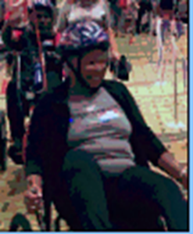
Find Us Inspiring Mobility and Independence @
www.grapevineambucs.org
grapevineamtryke@gmail.com
On FaceBook at Grapevine AMBUCS
Phone: 877-268-7953 or
By Mail at
2150 W. Northwest Highway
Suite 114, #1089
Grapevine, TX 76051

